Slide 1
CHAPTER 14: PROMOTION ESSENTIALS: TRADITIONAL MEDIA
McGraw-Hill Education
Part 5: Communicate the Value Offering

Slide 2
Learning Objectives
Understand the key types of advertising and the role of the creative agency.
Identify various approaches to sales promotion and how each might be used.
Describe the activities and aims of public relations.
Understand the role of selling in marketing communications
Learn the process of relationship selling.
Understand the major job of sales management.

Slide 3
Advertising
Advertising is a paid form of relatively less personal marketing communications, often through a mass medium to one or more target markets
Customers can quickly and easily become bored with any given advertising campaign, a concept referred to as advertising wearout.
Beyond a certain ad spending level, diminishing returns tend to set in.
Market share stops growing—or even begins to decline—despite continued spending.

Slide 4
Advertising Response Function
Advertising response function: Market share stops growing or declines, even with continued spending.
Marketers spend more on advertising early in the product life cycle.
Spending on promotional goals of informing and persuading has higher returns than equal spending on the goal of reminding.

Slide 5
Institutional Advertising
Institutional advertising promote an industry, company, family of brands, or some other issues broader than a specific product.
P&G runs ads for the Special Olympics also showing its brands.
Pork, the Other White Meat.
The Incredible Edible Egg.
Beef, It’s What’s for Dinner.

Slide 6
Types of Advertising
Product advertising is designed to increase purchase of a specific offering (good or service).
Pioneering | Competitive | Comparative
Intro and growth stages | Growth and maturity stages | Two or more brands compared
Rational appeal | Emotional appeal | Use if not the leader
Notes:
Pioneering advertising stimulates primary demand. Hence, it tends to be used during the introductory and early growth stages of the PLC when it is important to gain purchase by innovators and early adopters.
Marketing managers employ competitive advertising to build sales of a specific brand. Here, the appeal often shifts to more emotion and the goal is persuasion as well as providing information. Building a positive customer attitude toward the brand is a key component of competitive advertising, and this approach is heavily used during the growth and early maturity stages of the PLC.
In comparative advertising, two or more brands are directly compared against each other on certain attributes. Most experts recommend avoiding comparative advertising if your brand is the leader.

Slide 7
Advertising Execution and Media Types
Reach measures the percentage of the target market that is exposed to an advertisement.
Frequency is the number of times a person in the target market is exposed to the message.
Advertising execution is the way an ad communicates the information and image.

Slide 8
Common Approaches to Advertising Execution
EXHIBIT 14.2
Slice of Life | Portrays regular people in everyday settings. Example: a college student using Tide in a Laundromat.
Humor | Gains attention and interest through humorous portrayal. Example: Budweiser’s famous frogs are not soon forgotten.
Mood/Affect | Sets a positive tone around the offering. Example: Sandals Resorts provide visual images to back their theme of “Luxury Included.”
Research Based | Often used in comparative ads, a brand provides scientific evidence of its superiority. Example: L’Oréal Youth Code products message the science behind their development.
Demonstration | Physically shows how the product works. Example: Bounty paper towels are regularly shown on TV ads as having superior absorbency.
Musical | Uses music or a specific song to connect directly to a brand or product. Example: Jingles may not be as pervasive as in the past, but Subway has immortalized the “Five-Dollar Footlong” to music.
Endorser | Connects a celebrity posing as an authority figure (with appropriate disclaimer), company officer, or everyday consumer to sanction and support a product’s use. Example: Jamie Lee Curtis for Activia yogurt.
Lifestyle | Portraying ways a product will connect with a target customer’s lifestyle. Example: Dodge Ram pickup trucks navigating through the back roads of America.
Fantasy Creation | A fantasy look at how it might be when a customer purchases the product. Example: Taco Bell’s “Live Más” ads.
Animation and Animal | An animal or animated character featured in ads, sometimes as a spokesperson. Example: the GEICO gecko.

Slide 9
Advertising Media
Advertising Media
Television
Radio
Newspapers
Magazines
Outdoor (billboards, bus and train signs, etc.)
Direct mail
Internet and social media

Slide 10
Pros and Cons of Key Advertising Media
EXHIBIT 14.3
Type of Media | PROS | CONS
Television | Combines multimedia. Appeals to multiple senses. Works for both mass coverage or selected markets. Infomercial option. | Impressions are fleeting. Short shelf life. Din (clutter) of competing ads. TiVo effect (cutting out ads). High cost.
Radio | Quick placement and high message immediacy. Easy selectivity by market and station programming. Low cost. Geographic flexibility. | Audio only. Short shelf life. Din of competing ads.
Newspapers | Flexible. Timely. Highly credible medium. | Short shelf life. Big city and national papers can be very costly. Poor reproduction quality, especially in color. Low pass-along rate.
Magazines | Many titles, offers high geographic, demographic, and lifestyle selectivity. Good reproduction quality and color. High pass-along rate. | Long lead time for ad placement due to production. Final location of ad within the publication often cannot be guaranteed.
Outdoor | Repeat exposure in heavy traffic areas. Relatively low cost. Fewer competing ads. Easy geographic targeting. | Space and structure limits creative execution. Sometimes requires longer than desired commitments to a location. Public discontent over environmental clutter.
Direct mail | High audience selectivity. Creates feel of one-to-one marketing. Flexible. | Overuse and “junk mail” image. Too many competing ads. Relatively high cost.
Internet and social media | Interactive capabilities. Flexible. Timely. Low cost per exposure. | Reader in control of exposure (click-through). SPAM. Variations in connectivity speed and computers.

Slide 11
The Role of the Creative Agency
Advertising and PR are among the most outsourced functions in marketing, and with good reason.
Most organizations naturally focus on their own product or service expertise, thus developing sufficient internal expertise would be costly and detract from the core business.
Strategic partnerships between creative agencies and full-service web builders is a major trend today.
Notes:
Today the trend is toward more full-service creative agencies and even toward integration of marketing planning and branding services with traditional agency tasks. Almost always a client is billed an hourly rate, plus the costs of media purchases. Over the past several years, another major trend has been the development of strategic partnerships between creative agencies and full-service web builders. For many marketers, the website is the core of their marketing communications strategy.
Over the past several years, another major trend has been the development of strategic partnerships between creative agencies and full-service web builders. For many marketers, the website is the core of their marketing communications strategy. Often a new-product introduction or rebranding initiative focuses largely on the website, with print and other media types used primarily to drive customers to the web. Some of the very largest agencies have even established their own comprehensive web operations and are able to perform a full gamut of web services for clients including website building and maintenance, hosting, management of direct e-mail correspondence with customers, and management of the client’s overall CRM system.

Slide 12
Sales Promotion
Sales promotion is a promotion mix element that provides an inducement for an end-user consumer to buy a product or for a salesperson or someone else in the channel to sell it.
Use at the action (behavior) stage of the AIDA model.
Attention
Interest
Desire
Action
17-12

Slide 13
Sales Promotion: Consumers
To Consumers
Used to increase product trial, distribution, sagging sales, or rekindle brand interest.
Often many forms of sales promotion used together.
Too much reliance can backfire on a firm as customers buy only when a promotion is offered or it leads to cheapening the brand and distrust by customers.
Notes:
One problem that some department stores face is overuse of couponing and special sales. If you have a J.C. Penney or Macy’s in your town, you know that they are busy on weekends and holidays because of heavy reliance on sales.
Sales promotion to consumers is pull strategy.

Slide 14
Consumer Sales Promotion Options (slide 1)
EXHIBIT 14.4
Sales Promotion Approach | Description | Comments | Example
Product sampling | A physical sample of the product is given to consumers. | Excellent for inducing trial. Sample can be received by mail or in a store. | Gillette sends out a free razor to induce switching from an older model.
Coupons | An instant price reduction at point of sale, available in print media, online, or in-store. | Coupons usage is generally down among consumers. Still a good inducement to “buy now.” | Inside the free razor you received from Gillette you find a coupon for $1.00 off the purchase of your next pack of blades.
Rebates | A price reduction for purchase of a specific product during a specific time period. | Possibly instant at point of sale, but more frequently requires submission and delay in processing. | Sharpe offers a $100 rebate through Best Buy for purchase of a flat screen television during the month of February.
Contests and sweepstakes | Appeal to consumers’ sense of fun and luck. May suggest a purchase but legally must be offered without a purchase requirement. | Contests require some element of skill beyond mere chance. Sweepstakes are pure chance. | McDonald’s famous Monopoly game—the more you eat, the more you play (and vice-versa!).
Premiums | Another product offered free for purchasing the brand targeted in the promotion. | Gives the customer a bonus for purchase. Products may be complementary or unrelated. | Burger King offers the latest Spider Man toy with purchase of a meal.

Slide 15
Consumer Sales Promotion Options (slide 2)
EXHIBIT 14.4
Sales Promotion Approach | Description | Comments | Example
Multiple-purchase offers | Incentive to buy more of the brand at a special price. | Typically “buy two, get one free” or similar. | Centrum Vitamin offer—buy a bottle of 100, get an extra mini-bottle of 20.
Point-of-purchase materials | Displays set up in a retail store to support advertising and remind customers to purchase | Especially good at driving purchase toward a featured brand in a product category at the store aisle. | Standup display and front window poster in Blockbuster of the latest DVD release.
Product placements | Having product images appear in movies, on television, or in photographs in print media. | Strong connections with the show or story, as well as to any associated celebrities. | Coca-Cola cups always on the desks of the American Idol judges.
Loyalty programs | Accumulate points for doing business with a company. Designed to strengthen long-term customer relationships and reduce switching. | Especially popular among the airline and hospitality industry. Credit-card providers often facilitate. | American Airlines AAdvantage program, facilitated by CitiCard MasterCard and American Express cards.

Slide 16
Sales Promotion
To Channel Members
Push strategy used to increase sales by distributors, brokers, agents, and other middlemen.
Trade shows.
Cooperative advertising and promotion.
Allowances.
Contests and POP displays.
Notes:
Sometimes money is made available for a channel member in the form of a special payment for selling certain products, making a large order, or other specific performance. This form of channel-focused sales promotion is called an allowance.

Slide 17
Public Relations (PR)
PR is a systematic approach to influencing attitudes, opinions, and behaviors of customers and others.
PR is often executed through publicity, which is an unpaid and relatively less personal form of marketing communications usually through news stories and mentions at public events.

Slide 18
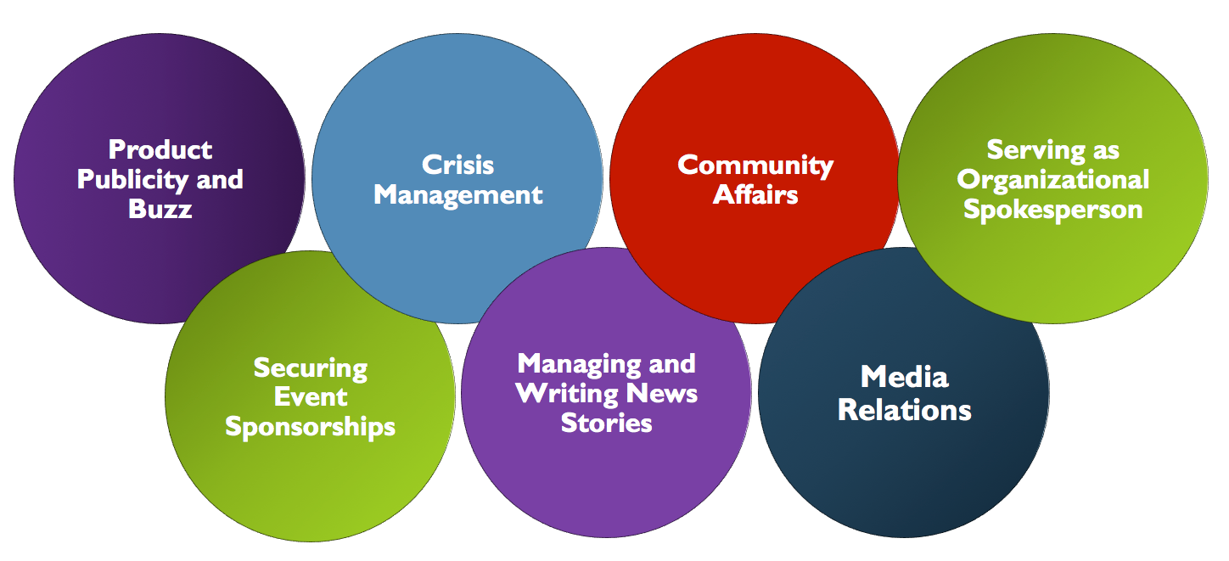
Responsibilities of a PR Department
Link to long alt text description
Notes:
During the introductory phase of the PLC, communication of information is a central promotional goal. The most credible and trusted information sources for potential customers are those that write or tell about a product for free. Newspaper and magazine articles, web postings and blogs, social marketing websites, news stories on television and radio—all of these forms of communication can be cultivated through an active PR program.
Event sponsorships, having your brand and company associated with events in the sports, music, arts, and other entertainment communities, can add tremendous brand equity and also provide substantial exposure with the right target customers. Event sponsorships have become a mainstay of promotional strategy. A huge success story for marketers in event sponsorship is NASCAR, which appeals to millions of loyal and passionate racing fans. Consumers transfer the loyalty and passion about NASCAR directly to the brands represented by the sponsorships.
Crisis management is a planned, coordinated approach for disseminating information during times of emergency and for handling the effects of unfavorable publicity.

Slide 19
Gaining Product Publicity and Buzz
In the intro phase of the PLC, when communication is a major goal, potential customers trust sources that provide free information about a product or service. This includes newspapers, magazines, TV, radio, web postings, blogs, social marketing websites.
Even though the media are free, securing the story placement may not be when the hours of work of the PR staff are included.
If buzz, or word-of-mouth, is created, especially through social media, the impact can create a cultural phenomenon.

Slide 20
Public Relations
Securing event sponsorships in sports, music, arts, and other entertainment add brand equity (e.g., NASCAR).
Issue sponsorship: McDonald’s has taken a stand against obesity since the movie Super Size Me.
Crisis management is planning how to handle emergencies and unfavorable publicity.

Slide 21
Toward a More Personal Communication with the Customer
Interactive communication enables companies to create a conversation with their customers.
Companies need tools to communicate directly with the customer.
Firms want direct feedback from the customer.

Slide 22
Personal Selling: Advantages
Three distinct advantages over other marketing communications methods:
Immediate feedback to the customer.
Ability to tailor the message to the customer.
Enhance the personal relationship between company and customer.
Notes:
Immediate feedback to the customer. Customers don't want to wait for information. They demand accurate information quickly, putting pressure on companies for immediate, personal communication with a salesperson or customer service representative.
Ability to tailor the message to the customer. No other marketing communication method does a better job of creating personal, unique customer messages in real time. Salespeople generate distinctive sales messages that directly address customer problems and concerns.
Enhance the personal relationship between company and customer. Salespeople and the personal selling function are the single most effective approach for establishing and enhancing the personal relationship between company and customer. In particular, business-to-business (B2B) customers' appreciate the efficiency of the Internet and other communication tools but expect a personal relationship with their suppliers.

Slide 23
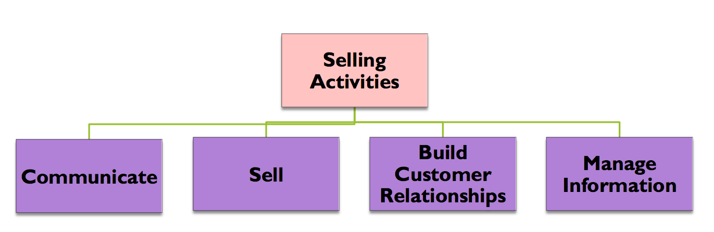
Personal Selling: Key Activities
Personal selling is a two-way communication process between salesperson and buyer with the goal of securing, building, and maintaining long term relationships with profitable customers.
Notes:
Communicate: Effective communication is an essential selling activity. As the point of contact between customer and company, a salesperson must communicate effectively with both. A sales force needs good presentation skills and should be able to use technology. Useful listening post for the firm. They hear what customers say about their needs, new product ideas, and competitors.
Sell: Selling requires a specific, complex set of tasks to reach the point where the customer agrees to purchase the product. From customer research early in the process through the sales presentation and customer support after purchase, the sales process is difficult.
Build Customer Relationships: Customers demand a close, strategic relationship with suppliers, and, as the primary point of contact with the company, salespeople are expected to build and support the customer relationship. This means spending time with the customer, developing excellent customer relationship management skills, and ultimately building trust with a customer.
Manage Information: Salespeople today must be excellent information managers, collecting information from a variety of sources (their own company, customers, competitors, and independent information sources), determining what is relevant, and then presenting it to the customer. For example, managing the flow of customer information inside the company to ensure the right people get the right information at the right time takes time and follow-up.

Slide 24
Matrix of Selling Activities
EXHIBIT 14.5
 | Communicate | Sell | Build Customer Relationships | Manage Information
Technology | E-mail. Make telephone calls and leave voicemail messages. | Script sales pitch. Create customer-specific content. Provide relevant technology to customers. | Create useful company web page content. Develop good team skills inside the company. | Develop database management skills to manage customer database.
Non-technology | Enhance language and overall communication skills. Develop effective presentation skills. | Learn relationship selling skills. Conduct research of customer’s business. Define and sell value-added services to customer. Follow up after customer contact. Identify and target key customer accounts. Listen effectively. | Develop strong supplier alliances. Build rapport with all members of the customer’s buying center. Network inside the company and throughout the customer’s business. Build trust. Coordinate customer relationships inside the company. | Develop time-management skills. Organize information flow to maximize the effectiveness and reduce irrelevant data.

Slide 25
Personal Selling: The Most Personal Form of Communication
In terms of sheer numbers, most salespeople are employed in various kinds of retail selling, also called B2C (business-to-consumer).
Much more relationship selling is done by salespeople in B2B (business-to-business) markets.
Goods and services sold by B2B salespeople are more expensive and technically complex than in B2C.
B2B customers tend to be larger and have an extensive decision-making process.

Slide 26
Classifying Sales Positions
Trade Servicer
Missionary Seller
Technical Seller
Solution Seller
Notes:
The P&G salesperson selling soap products to individual store managers in a large grocery chain is an example of a trade servicer.
Seller Missionary: salespeople often do not take orders from customers directly but persuade customers to buy their firm's product from distributors or other suppliers; for example, a pharmaceutical rep.
An example of technical selling is the sales engineer from General Electric who calls on Boeing to sell the GE90 jet engine to be used in Boeing aircraft.
Solution Seller: More and more customers look for strategic partners who provide comprehensive solutions to their business problems. Key account salespeople, those responsible for managing large accounts, are skilled in developing complex solutions to a particular customer problem.

Slide 27
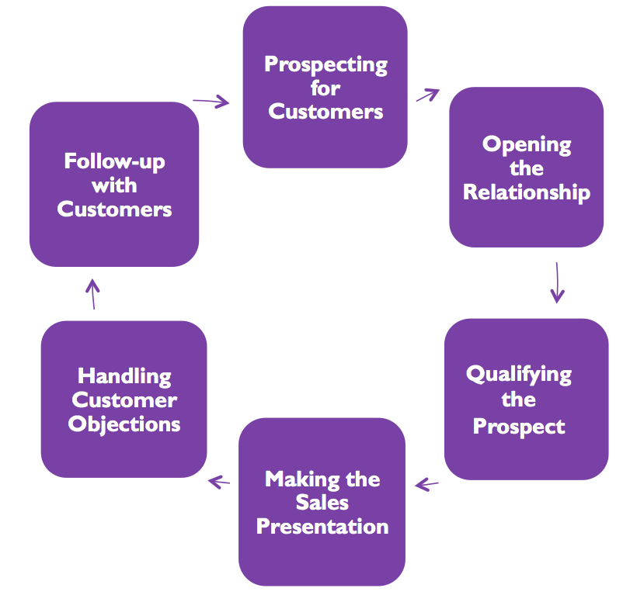
The Personal Selling Process
Link to long alt text description

Slide 28
Personal Selling: Prospecting and Opening
Prospecting for customers.
Outbound telemarketing.
Inbound telemarketing.
Opening the relationship.
Determine who has the influence or authority to buy.

Slide 29
Personal Selling: Qualifying the Prospect
Qualifying the prospect.
Does the prospect have a need for the company’s products?
Can the prospect derive added value from the product in ways that the company can deliver?
Can the salesperson effectively contact, communicate, and work with the prospect over an extended period of time?
Does the prospect have the financial ability and authority to make the sale?
Will the sale be profitable for the company?

Slide 30
Personal Selling: Prospecting for Customers
Prospecting for customers.
Use a variety of sources to identify prospects including trade and industry directors, other customers and suppliers, and referrals.
Outbound telemarketing is through phone calls to prospects at home or office.
Inbound telemarketing gives prospects a toll-free number to call for more information.
Firms have teams devoted to Internet lead generation and customer inquiries.
Notes:
Telemarketing and other direct marketing efforts are also used to generate prospective customers. Outbound telemarketing involves calling potential customers at their home or office, either to make a sales call via telephone or to set up an appointment for a field salesperson. Inbound telemarketing, where prospective customers call a toll-free number for more information, is also used to identify and qualify prospects.
When prospects call for more information, a telemarketing representative determines the extent of interest and assesses the prospect qualifications, then passes the contact information on to the appropriate salesperson. The Internet has the ability to generate potential new customer leads and a number of companies have dedicated teams to manage their Internet lead generation and customer inquiries. In addition, many companies, particularly those selling complex products, provide technical product information to customers. Salespeople, assigned in some firms specifically for Internet customers, follow up on legitimate inquiries with a traditional sales calls.

Slide 31
Personal Selling: Opening the Relationship
Opening the relationship.
Determine who has the most authority or influence.
If the product is complex, salespeople may call on employees across the firm.
Sales teams will work with employees across the organization when may people are involved in the decision-making process.

Slide 32
Personal Selling: Qualifying the Prospect
Qualifying the prospect.
Does the prospect have a need for the company’s products?
Can the prospect derive added value from the product in ways that the company can deliver?
Can the salesperson effectively contact, communicate, and work with the prospect over an extended period of time?
Does the prospect have the financial ability and authority to make the sale?
Will the sale be profitable for the company?

Slide 33
Personal Selling: The Sales Presentation
Making the sales presentation.
Setting goals and objectives to obtain action.
Educate the customer by providing enough knowledge about the company's products.
Get the customer's attention.
Build interest for the company's products.
Nurture the customer's desire and conviction to purchase.
Obtain a customer commitment to action (purchase).
Characteristics of a great sales presentation (next slide).
Notes:
In reality, sales presentations are carefully choreographed interactions in which the salesperson tries to discern the customer’s real needs while at the same time providing critical information in a persuasive way so the customer appreciates the benefits and advantages of the product. Remember, the goal is not simply to make the sale but to create a strong value proposition that will lead to a mutually beneficial long-term relationship.
Setting goals and objectives is the first step in communicating. Ultimately, the goal of the presentation is to secure a purchase commitment from the customer. However, the salesperson does not just walk in asking for the purchase order. Successful salespeople understand that the purchase order does not come until customers believe the company’s products offer the best solution to their needs. In defining the goal, salespeople consider where the customer is in the buying process and have a clear understanding of the customer relationship.

Slide 34
CHARACTERISTICS OF A GREAT SALES PRESENTATION
EXHIBIT 14.3
Characteristic | Answers the Customer Question
Explains the value proposition | What is the value added of the product?
Asserts the advantages and benefits of the product | What are the advantages and benefits of the product?
Enhances the customer’s knowledge of the company, product, and services | What are the key points I should know about this company, product, and their services?
Creates a memorable experience | What should I remember about this presentation?

Slide 35
Personal Selling: Handling Objectives
Handling objections and negotiating win-win solutions.
Some common customer concerns:
Product need: Offers a better solution
Price: Show benefits exceed price
More time: Value proposition not clear
Company trust: Unfamiliar with the seller

Slide 36
Personal Selling: Closing and Follow-Up
Closing the sale – Four mistakes:
Negative attitude
Lack of preparation
Too much talking; not enough listening
“One size fits all” approach
Follow-up after the sale – What customers expect
Delivery, installation, and initial service
Training for proper operation
Effective and efficient complaint resolution

Slide 37
Personal Selling: Organizing the Sales Force
Organizing the sales force (company sales force or independent agents).
Economic
Control
Transaction costs
Strategic flexibility
Notes:
Economic: Basic analysis of the costs and expected revenue associated with maintaining a sales force is weighed against outsourcing to independent agents.
Control: A critical factor is the amount of control senior management believes is necessary for the sales function. A company sales force offers complete control in key areas such as recruiting, training, and compensation. On the other hand, independent agents operate without direct company management supervision.
Transaction costs: Finding a good replacement for a poor-performing independent sales agent can be difficult, and once one is found, it is often months before the new agent learns enough about the product and its applications to be effective in the sales job. Transaction cost analysis (TCA) states that when substantial transaction-specific assets are necessary to sell a manufacturer's product, the cost of using and administering independent agents is likely higher than the cost of hiring and managing a company's sales force.
Strategic flexibility: In general, a vertically integrated distribution system incorporating a company sales force is less flexible than outsourcing. Independent agents can be added or dismissed at short notice, especially if no specialized assets are needed to sell the product. Furthermore, it is not necessary to sign a long-term contract with independent agents. Firms facing uncertain and rapidly changing competitive or market environments and industries characterized by shifting technology or short product life cycles often use independent agents to preserve flexibility in the distribution channel.

Slide 38
Organizing the Sales Force: Geographic Orientation
Geographic orientation implies salespeople are assigned separate geographic territories.
Advantages:
Lowest cost.
Minimizes customer confusion.
Disadvantage:
No division of labor.
Salespeople have to be good at many things.
Notes:
The geographic sales orientation has several advantages. First, and most importantly, it tends to have the lowest cost because (1) there is only one salesperson in each territory, (2) territories tend to be smaller than other organizational structures so travel time and expenses are minimized, and (3) fewer managerial levels are required for coordination so sales administration and overhead expenses are lower. Second, the simplicity of the geographical structure minimizes customer confusion because each customer is called on by one salesperson.

Slide 39
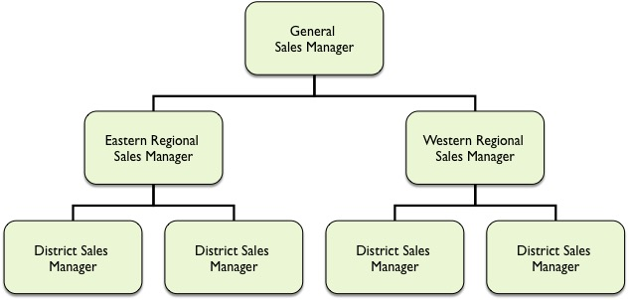
EXAMPLE OF GEOGRAPHIC ORIENTATION
EXHIBIT 14.9
Link to long alt text description
Source: Adapted from Mark W. Johnston and Greg W. Marshall, Sales Force Management, 12th ed. 2016 Routledge Publishing

Slide 40
Organizing the Sales Force: Product Orientation
Product orientation.
Many firms organize the sales force along product lines.
Advantages are focus on product knowledge, closer relationship between sales and engineering, product development and manufacturing. Managers have greater control of the selling effort.
Disadvantages are more sales people in the geographic region which leads to higher costs.
Notes:
The primary advantage of a product orientation is that individual salespeople can develop familiarity with the technical attributes, applications, and most effective selling methods associated with a single product. Also, there tends to be a closer relationship between sales and engineering, product development, and manufacturing when salespeople focus on one product or product category. Finally, this structure enables greater control in the allocation of selling effort across various products.

Slide 41
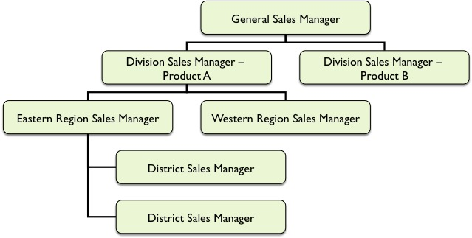
EXAMPLE OF PRODUCT ORIENTATION
EXHIBIT 14.10
Link to long alt text description
Source: Adapted from Mark W. Johnston and Greg W. Marshall, Sales Force Management, 12th ed. 2016 Routledge Publishing

Slide 42
Organizing the Sales Force: Market Orientation
Customer type or market organization.
IBM pioneered when it assigned sales teams to small or large firms.
Reflects a market segmentation strategy.
Salespeople can use different selling approaches.
Salespeople become very familiar with customers’ specific needs and may discover ideas for new products and marketing approaches for their customers.
The disadvantage may be higher sales costs with many salespeople in a region.

Slide 43
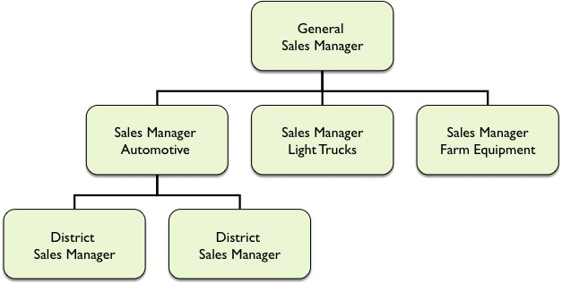
EXAMPLE OF MARKET ORIENTATION
EXHIBIT 14.11
Link to long alt text description
Source: Adapted from Mark W. Johnston and Greg W. Marshall, Sales Force Management, 9th ed. (New York: McGraw-Hill, 2009), p. 116.

Slide 44
Managing the Sales Force: Performance
Performance: motivating the sales force.
Managing a sales force involves five primary responsibilities:
Role perceptions
Sales aptitude
Skill levels
Motivation
Personal, organizational, and environmental factors
Rewards:
Intrinsic
Extrinsic
Satisfaction
Notes:
Role Perceptions The role of a salesperson is the set of activities or behaviors he or she must perform on the job. This role is largely defined through the expectations, demands, and pressure communicated to the salesperson by role partners. These partners include people inside as well as outside the company with a vested interest in how a salesperson performs the job—top management, the salesperson’s sales manager, customers, and family members. How salespeople perceive their roles has significant consequences that affect job satisfaction and motivation, which, in turn, have the potential to increase sales force turnover and hurt performance.
Sales Aptitude: Are Good Salespeople Born or Made? Sales ability has historically been considered a function of (1) physical factors such as age and physical attractiveness, (2) aptitude factors such as verbal skills and sales expertise, and personality characteristics such as empathy. However, there is no proof these measures, by themselves, affect sales performance. As a result, most managers believe the things a company does to train and develop its salespeople are the most important determinants of success.
Sales Skill Levels. Sales skill levels are the individual’s learned proficiency at performing necessary sales tasks. They include such learned abilities as interpersonal skills, leadership, technical knowledge, and presentation skills. The relative importance of each of these skills and the need for other skills depend on the selling situation.
Motivation. Motivation is how much the salesperson wants to expend effort on each activity or task associated with the sales job.
Organizational, Environmental, and Personal Factors. Organizational factors include the company marketing budget, current market share for the company’s products, and the degree of sales management supervision. Personal and organizational variables such as job experience, the manager’s interaction style, and performance feedback influence the amount of role conflict and ambiguity salespeople perceive. In addition, the desire for job-related rewards (such as higher pay or promotion) differs with age, education, family size, career stage, and organizational climate.
Rewards. Extrinsic rewards are those controlled and given by people other than the salesperson such as managers and customers. They include pay, financial incentives, security, recognition, and promotion. Intrinsic rewards are those salespeople primarily attain for themselves and include feelings of accomplishment, personal growth, and self-worth.
Satisfaction. Salesperson job satisfaction refers to all the characteristics of the job individuals find rewarding, fulfilling, and satisfying—or frustrating and unsatisfying. Satisfaction is a complex job attitude and salespeople can be satisfied or dissatisfied with many different aspects of the job.

Slide 45
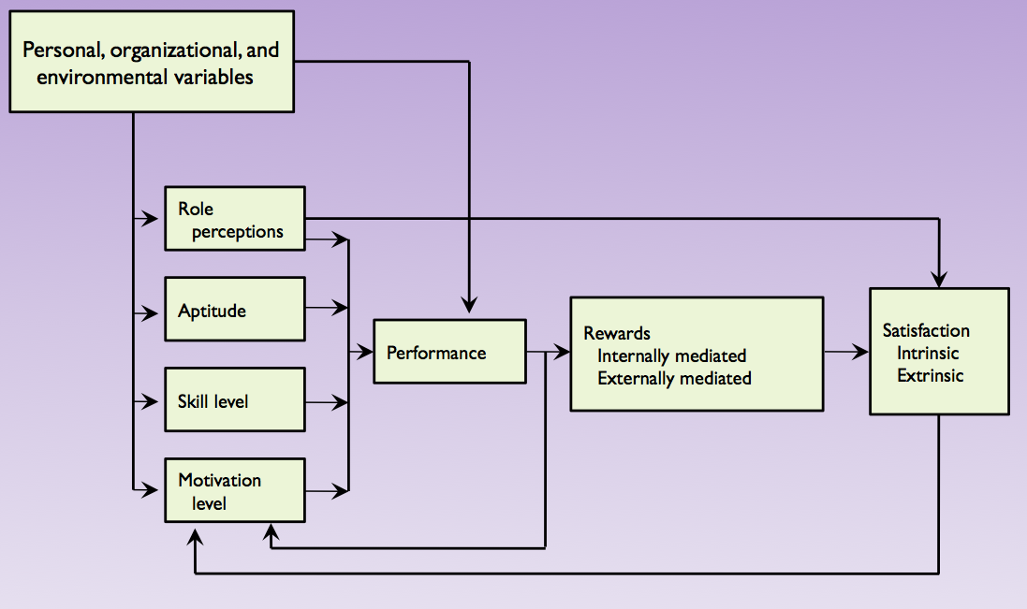
MODEL OF SALESPERSON PERFORMANCE
EXHIBIT 14.12
Link to long alt text description
Source: Mark W. Johnston and Greg W. Marshall, Sales Force Management, 9th ed. (New York: McGraw-Hill, 2009), Exhibit 6.1, pg. 200.

Slide 46
Managing the Sales Force: Recruiting and Training
Recruiting and selecting salespeople.
Analyze the job and determine the selection criteria.
Find and attract a pool of applicants.
Develop and apply selection procedures to evaluate applicants.
Training.
Improve customer relationships.
Increase productivity.
Improve morale.
Lower turnover.
Improve selling skills.

Slide 47
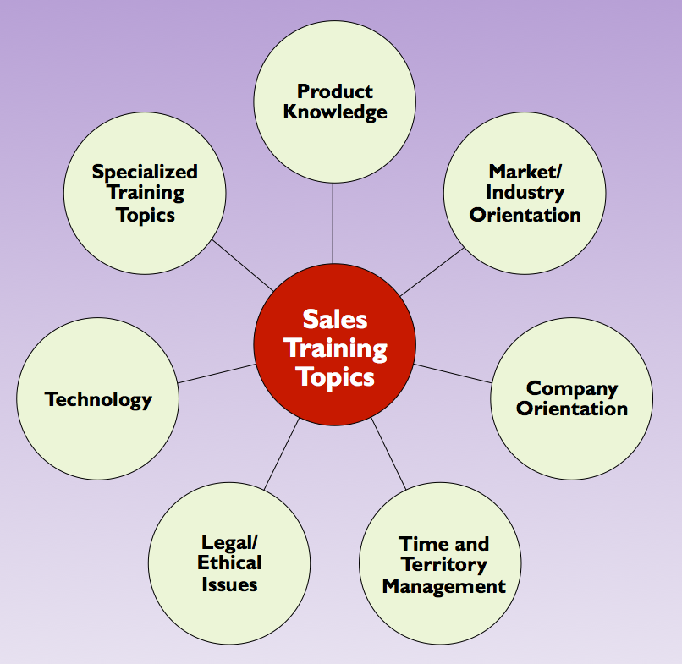
SALES TRAINING TOPICS
EXHIBIT 14.13
Link to long alt text description
Source: Mark W. Johnston Greg W. Marshall, Relationship Selling, 12nd ed. 2016 Routledge Publishing.

Slide 48
Compensation and Rewards
Salary: fixed sum.
Incentive pay encourages better performance.
Commissions are tied to sales volume or profitability.
Bonuses are tied to meeting quotas like products.
Nonfinancial incentives include promotional opportunities.

Slide 49
Evaluating Salesperson Performance
Understand controllable and non-controllable factors
If sales are falling because the economy is not doing well, the salesperson should not be punished.
If sales are failing because of poor performance, then the salesperson should be held accountable.

Slide 50
Alt Text Appendix
All long alt text descriptions are included in this appendix.

Slide 51
Responsibilities of a PR Department
The responsibilities of a PR department relate to product publicity and buzz; securing event sponsorships; crisis management; managing and writing news stories; community affairs; media relations; and serving as organizational spokesperson.

Slide 52
The Personal Selling Process
The personal selling process has six steps. The are: prospecting for customers, opening the relationship, qualifying the prospect, making the sales presentation, handling customer objections, and follow-up with customers. The cycle then starts over.

Slide 53
Example of Geographic Orientation
An organizational chart shows how sales management can be structured with a geographic orientation. At the top of the chart is the general sales manager. Directly reporting to the general sales manager are the eastern and western regional sales managers. Directly reporting to each regional sales manager are two district sales managers.

Slide 54
Example of Product Orientation
An organizational chart shows how sales management can be structured with a product orientation. At the top of the chart is the general sales manager. Directly reporting to the general sales manager are two division sales managers, one for Product A and the other for Product B. Directly reporting to the division sales manager for Product A are the eastern and western region sales managers. Reporting to the eastern region sales manager are two district sales managers.

Slide 55
Example of Market Orientation
An organizational chart shows how sales management can be structured with a market orientation. At the top of the chart is the general sales manager. Directly reporting to the general sales manager are the sales manager of automotive, the sales manager of light trucks, and the sales manager of farm equipment. Directly reporting to the sales manager for automotive are two district sales managers.

Slide 56
Model of Salesperson Performance
In this model of salesperson performance, personal, organizational, and environmental variables are what all other factors flow from, either directly or indirectly. These variables directly influence performance. They also directly impact four other factors. Those are role perceptions, aptitude, skill level, and motivation level. These four factors directly influence performance. Performance directly influences rewards, which can be internally mediated or externally mediated. Rewards determine satisfaction, which can be intrinsic or extrinsic. Role perceptions also have a direct influence on satisfaction. Finally, performance, rewards, and satisfaction support motivation level, creating a feedback loop.

Slide 57
Sales Training Topics
Sales training topics include: product knowledge; market/industry orientation; company orientation; time and territory management; legal/ethical issues; technology; and specialized training topics.

